Slide 1
Edited version of original by Kezia Matthews from Shere Infant School & Nursery

Slide 2
Bubbles: You may have heard people talking about ‘bubbles’. This means a group of people who work with each other but no-one else. We are all now in bubbles and this is to keep us safe. Our bubble is called XXX.
Does anyone have any questions? Does everyone understand?

Slide 3
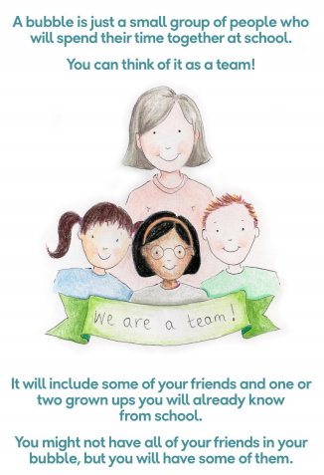

Slide 4
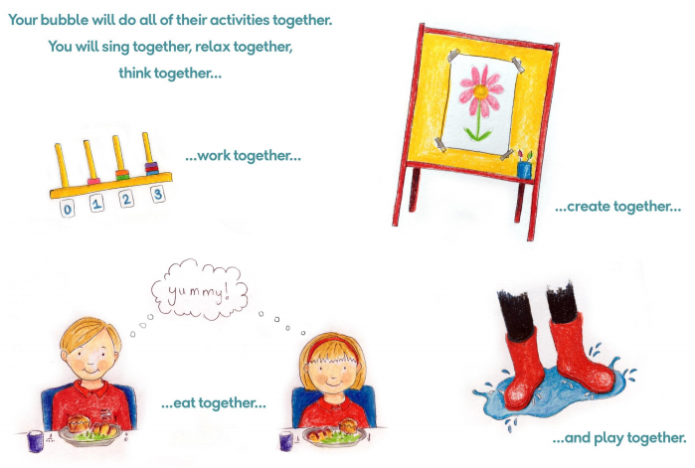

Slide 5
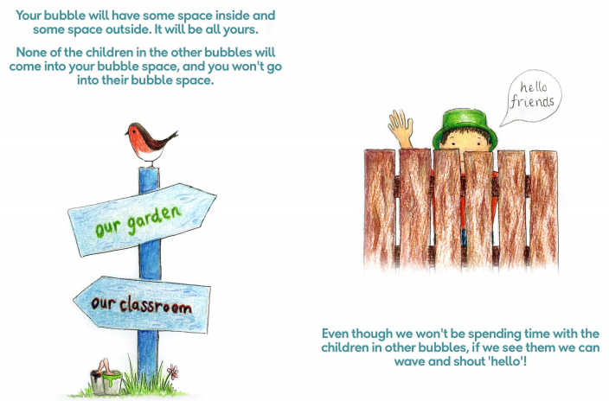

Slide 6
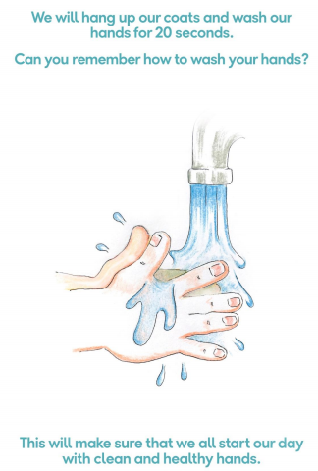
Handwashing: when you arrive in the classroom you will sit at your desk until your teacher tells you to wash your hands for 20 seconds. You’ll also need to wash them for 20 seconds before and after break times, before and after lunch times and before you leave at the end of the day.
Does anyone have any questions? Does everyone understand?

Slide 7
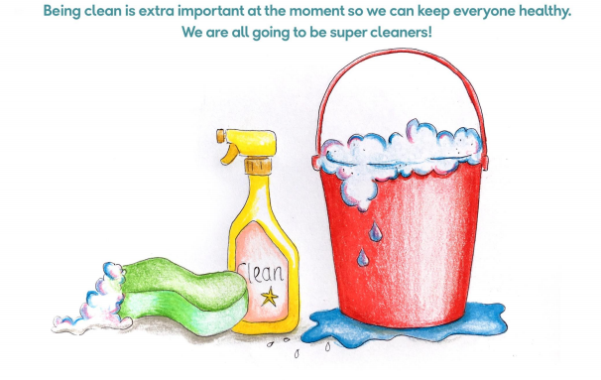

Slide 8
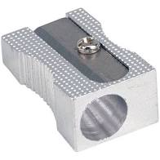
Classroom: the equipment on your desks is yours and can only be used by you. Your book is for working in but it won’t be collected in and you will be marking work yourself. If you use a tissue you must ask before putting it into the bin and then wash your hands for 20 seconds.
It’s really important that you stay in your seat – if you need
something or want to ask something, just put up your hand.
I won’t be able to come to your desk but I will do my best to
help you or answer your question.
If you need to sharpen your pencil, take a tissue, place it on your desk and sharpen your pencil onto it. You can then carefully fold your tissue and keep it on your desk until the end of the day.
Does anyone have any questions? Does everyone understand?

Slide 9
Toilets: each bubble has their own toilet to use and only one person at a time will be able to go. To keep us safe, this is the only toilet you must use. Our toilets are...
When you have been to the toilet and washed your hands for 20 seconds, use paper towels to dry your hands and place them in the bin.
Does anyone have any questions? Does everyone understand?

Slide 10
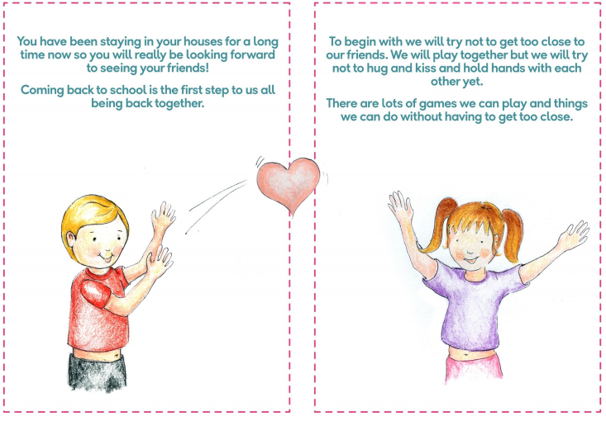

Slide 12
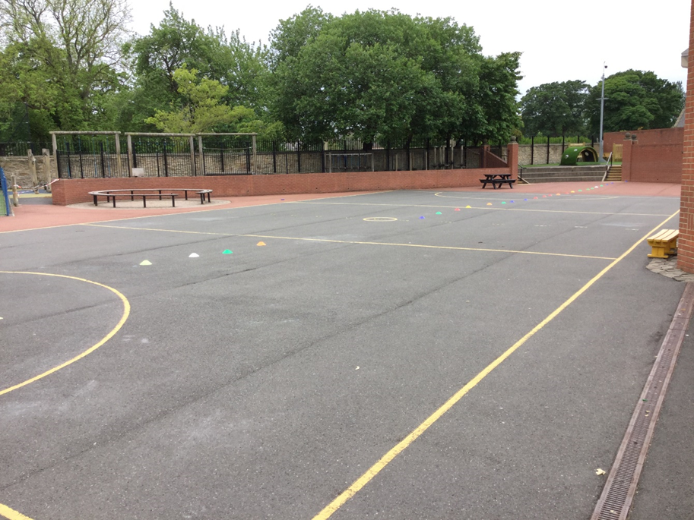
Break times: just as you come into school at different times, your break times will also be different. Each bubble will be out at a different time and you must stay 2m away from everyone in your bubble. We will play in zones on the big yard.
Does anyone have any questions? Does everyone understand?

Slide 13
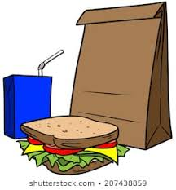
Lunchtimes: are also different. We will be having our lunch in the Dining Hall with the rest of the people from our bubble. You’ll wash your hands for 20 seconds before eating and then you will eat a packed lunch.
During lunch time you will have some time outside with the rest of the people in your bubble, this will be in one of the zoned areas. You must stay within your zoned area.
Does anyone have any questions? Does everyone understand?

Slide 14
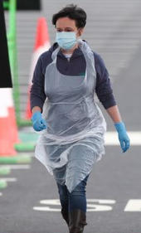
First aid: if anyone hurts themselves, either in the classroom or outside, a member of staff will go and get a first aider. You won’t go to the first aid room anymore.
This person may be wearing gloves, an apron and a mask, this is to keep everyone safe. If they need to go home, they will be taken to the Inclusion Room where they will wait until they are collected.
Does anyone have any questions? Does everyone understand?

Slide 15
Behaviour: everyone in school is expected to follow these rules and this is to keep everyone safe. If anyone chooses not to follow them, they, and their parents or carers, will be spoken to by a member of the leadership team.
If they continue to break the rules then they will not be allowed to return to school, in order to keep everyone safe.
You can earn Dojo points for being a super safe rule follower!
Does anyone have any questions? Does everyone understand?

Slide 16
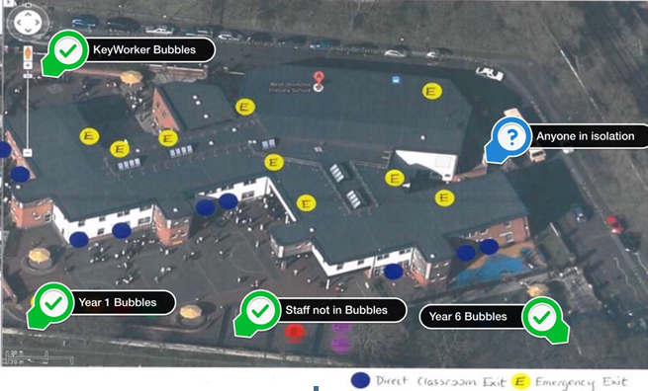
Evacuation guidelines: If we need to leave our classroom in case there’s a fire, XXX will leave the classroom first and I will tell each person when to follow them. You should keep 2m away from the person in front of you as you walk to the fire assembly point. I will close the classroom door when everyone has left and join you on the yard. Fire marshals will check the building to make sure everyone is safe.
Does anyone have any questions? Does everyone understand?

